Slide 1
Understanding Generative AI Tools
Overview
In this lesson students will be introduced to some core foundational principles of Generative AI tools like ChatGPT.
The lesson starts by defining AI and large language models, moves into breaking down how they function, then finishes off with a look at the implications AI has in the workplace and real world.
Learning Objectives
Define Large Language Models (LLMs) and Generative AI
Summarize how LLMs generates responses
Identify potential advantages and disadvantages of generative AI tools
Identify the real-world concerns and implications of generative AI tools
Skills: Summarize How LLMs Work, Identify Advantages and Disadvantages of generative AI Tools, Summarize Real-World Implications of AI

Slide 2
Suggested Agenda
Time | Activity
0:00–0:20 | What are Large Language Models
0:20–0:30 | What Else Can LLMs Do?
0:30–0:45 | Generative AI Tools in the Workplace
0:45–0:60 | Real World Concerns and Key Takeaways

Slide 3
Teaching Guide
Use the following quick tips for instructional guidance.
Title | What to Do
Our Learning Goals | Learning Objectives Slide Capture a screenshot of this slide and drop in the class discussion forum or Slack channel.
Group and Partner Exercises | Creating Breakout Rooms — Group and Partner Exercises Set up breakout rooms for student pairs/groups. Screenshot the slide and post it in the discussion forum or Slack channel before opening the rooms. At the 60-second mark, send a message to all rooms: “Start to wrap up your discussions. Rooms will close in one minute!” Move around from breakout room to breakout room to “walk around the classroom.”

Slide 4
Teaching Guide (Cont.)
Title | What to Do
Discussions | Whole-Class Discussions Screenshot the slide and put in the discussion forum or Slack channel. Some students may not have two monitors. You should stop sharing your screen so they can see each other’s faces during the discussion.
Solo Activities | Solo Activities Screenshot the slide and drop it in the discussion forum or Slack channel. For solo activities, you can choose to put people in group breakout rooms (to create the “table” group that they would be in in a physical setting) or allow students to work independently in the main session.
Homework | Share homework guidelines in the discussion forum or Slack channel.

Slide 5
Understanding Generative AI
Leveraging Generative AI

Slide 6
LEARNING OBJECTIVE
By the end of the lesson, you will be able to…
Define Large Language Models (LLMs) and Generative AI
Summarize how LLMs generate responses
Identify potential advantages and disadvantages of generative AI tools
Identify the real-world concerns and implications of generative AI tools
Notes:
Adjust objectives as needed

Slide 7

What are Large Language Models (LLMs)?
Understanding Generative AI Tools

Slide 8
Reliability and Accuracy
Discussion: Artificial Intelligence
Take a few moments to consider the question below
Be ready to share your answers to the class
What comes to mind when you hear Artificial Intelligence?
Notes:
PURPOSE: To activate students’ prior knowledge about AI in advance of learning new information.

Slide 9
Defining AI , Generative AI, and LLMs
Artificial Intelligence
The ability of machines to perform tasks that typically require human-like intelligence, such as learning, problem-solving, pattern recognition, and decision-making, using algorithms, data, and statistical models.
Generative AI
A type of artificial intelligence that is capable of creating new, original content, such as images, music, and text, based on the patterns and styles it has learned from a dataset.
Large Language Models
Computer programs or algorithms that are capable of processing and generating natural language text using vast amounts of data and statistical models.
Notes:
PURPOSE: To demonstrate to students that AI is much more than just programs like ChatGPT.
Feel free to include that chatGPT was used to help simplify these definitions!

Slide 10
Defining AI , Generative AI, and LLMs
Artificial Intelligence
The ability of machines to perform tasks that typically require human-like intelligence, such as learning, problem-solving, pattern recognition, and decision-making, using algorithms, data, and statistical models.
Generative AI
A type of artificial intelligence that is capable of creating new, original content, such as images, music, and text, based on the patterns and styles it has learned from a dataset.
Large Language Models
Computer programs or algorithms that are capable of processing and generating natural language text using vast amounts of data and statistical models.
Notes:
PURPOSE: To demonstrate to students that AI is much more than just programs like ChatGPT.
Feel free to include that chatGPT was used to help simplify these definitions!

Slide 11
Defining AI , Generative AI, and LLMs
Artificial Intelligence
The ability of machines to perform tasks that typically require human-like intelligence, such as learning, problem-solving, pattern recognition, and decision-making, using algorithms, data, and statistical models.
Generative AI
A type of artificial intelligence that is capable of creating new, original content, such as images, music, and text, based on the patterns and styles it has learned from a dataset.
Large Language Models
Computer programs or algorithms that are capable of processing and generating natural language text using vast amounts of data and statistical models.
Notes:
PURPOSE: To demonstrate to students that AI is much more than just programs like ChatGPT.
Feel free to include that chatGPT was used to help simplify these definitions!

Slide 12
Training a Machine Learning Model
Supervised Learning
Unsupervised Learning
Supervised learning is a type of machine learning where the model learns from labeled examples.
Unsupervised learning is a type of machine learning where the model learns from unlabeled data.
It's similar to having a teacher who provides correct answers for the model to learn from.
It's like exploring a dataset without a teacher, where the model tries to find patterns and structures on its own
Notes:
PURPOSE: To demonstrate to students that AI is much more than just programs like ChatGPT.
Feel free to include that chatGPT was used to help simplify these definitions!

Slide 13


Training a Large Language Model
1
2
Pre-training
Unsupervised Learning
Fine Tuning
Supervised Learning
Pre-training is the initial phase where a large language model is exposed to a vast amount of text data. The model learns the structure, patterns, and common language knowledge by assigning values to words and letters. It then uses its knowledge of patterns to predict the next word in a sentence.
The model is trained on a smaller, task-specific dataset. The model adapts its pretrained knowledge to perform well on the target task by adjusting its architecture and parameters. There is typically a human providing guidance to help the model learn at this stage.
Notes:
PURPOSE: To breakdown how LLMs are trained and tuned before they are ready to be used effectively.
TEACHING TIPS
Keep a log of any questions you may not know the answer to. After class, you may decide to do a bit of research and answer these questions in Slack for students to review.

Slide 14
How an LLM Generates Responses:
1
2
3
4
5
Input
The LLM receives a prompt or input, which is typically a piece of text that provides context or a question that requires a response
Tokenization
The LLM breaks down the input into individual words, or tokens, which it can then process and analyze
Encoding
Each token is then encoded into a numerical representation that the LLM can understand and manipulate
Processing
The LLM processes the encoded tokens by analyzing the patterns and relationships between them.
Output
The LLM generates a response by using the patterns and relationships it has learned during training to create new text that is relevant to the input
Notes:
PURPOSE: To breakdown how LLMs generate responses at a very high level. Be prepared to field questions and answer them to the best of your ability.
TEACHING TIPS
Keep a log of any questions you may not know the answer to. After class, you may decide to do a bit of research and answer these questions in Slack for students to review.

Slide 15
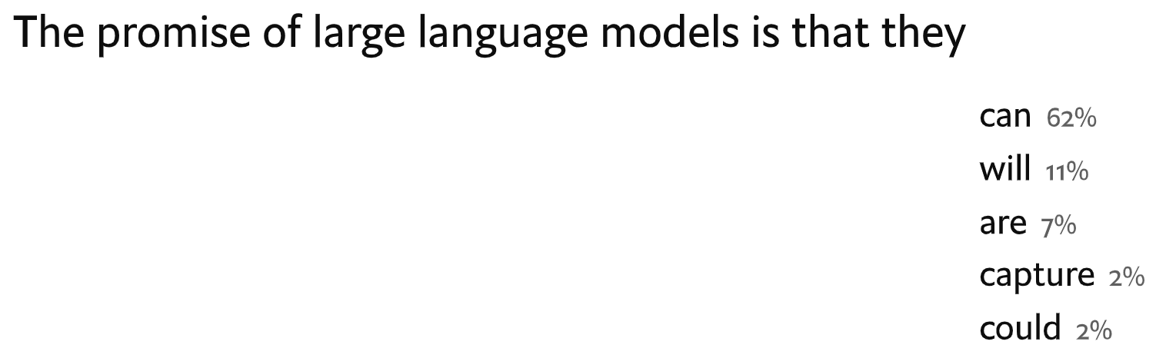
LLMs: A Giant Exercise in Statistics
At a very high level, LLMs like ChatGPT generate their responses one word at a time, based on probability.
However, probability isn’t the only factor - often times lower probability options result in a better output.
Notes:
Teaching Tips
The text in the white box is meant to show how an LLM “thinks” about what word to add next
The prompt for this could have been something like
“What is the promise of large language models?” or “Finish the sentence ‘The promise of large language models is that they…”
There is no need to get into the complexities of the calculations, but feel free to use this as an opportunity to elaborate on the process if you have time

Slide 16

Notes:
This is an optional video. If people seem a little lost, it might be a good idea to show it to reiterate some key points from the lesson so far.

Slide 17
What Else Can LLMs Generate?
Understanding Generative AI Tools

Slide 18

Images Based on User Inputs
Large Language Models can generate more than just text.
DALL-E 2 is another LLM created by OpenAI that can create realistic images based on the prompts it receives.
Prompt: A blue orange sliced in half laying on a blue floor in front of a blue wall.
Notes:
TEACHING TIPS
If you have access to DALL-E 2 it would be a good time to showcase the tool and enter the same prompt “A blue orange sliced in half laying on a blue floor in front of a blue wall.”
Let the results drive more conversation where appropriate

Slide 19

Reliability and Accuracy
Discussion: Image Generation
Take a few moments to consider the question below
Be ready to share your answers to the class
Given what you now know about how LLMs generate responses, how do you think AI tools like DALL-E-2 generate images?
Image generated using DALL-E 2
Notes:
PURPOSE: To give students a chance to make a prediction based on what they just learned about LLMs on the previous slides.
TALKING POINTS
See next slide.

Slide 20




DALL-E 2 Image Generator
prompt
Overly Simplified Explanation:
DALL-E 2 receives an input - the user’s prompt
The prompt is encoded, and DALL-E 2 tries to match parts of the prompt to images from its training data
DALL-E 2 starts predicting one part of the image at a time
Once DALL-E 2 thinks it has a complete image that matches the original prompt, it “spits” out the image for the user to see
Notes:
PURPOSE: Provide a brief explanation of how DALL-E 2 generates images
TEACHING TIPS
Explanation of #3: predicting one part of the image at a time.
Prompt: A blue orange sliced in half laying on a blue floor in front of a blue wall.
Start with a blue orange
Then an orange sliced in half
Then a blue floor
Then a blue wall
After predicting these parts it tries to fit them all together in a way that aligns with the prompt.
The first image is always too “noisy”
The model takes away the extra “noise” over and over again until it has something that matches the prompt.
If you are interested, this video goes into great detail on the topic

Slide 21
Generative AI Tools In the Workplace
Understanding Generative AI Tools

Slide 22
AI Tools in the Workplace
5 Minutes
Partner Exercise:
Generative AI Tools in the Workplace
Work with a partner or small group and brainstorm together
Keep track of your list on a piece of paper
Be ready to share!
Create a list of ways you could use AI in your day-to-day workflow.
Notes:
TEACHING TIPS
Before feilding responses, go to the next slide and fill in the chart with responses from the class.

Slide 23
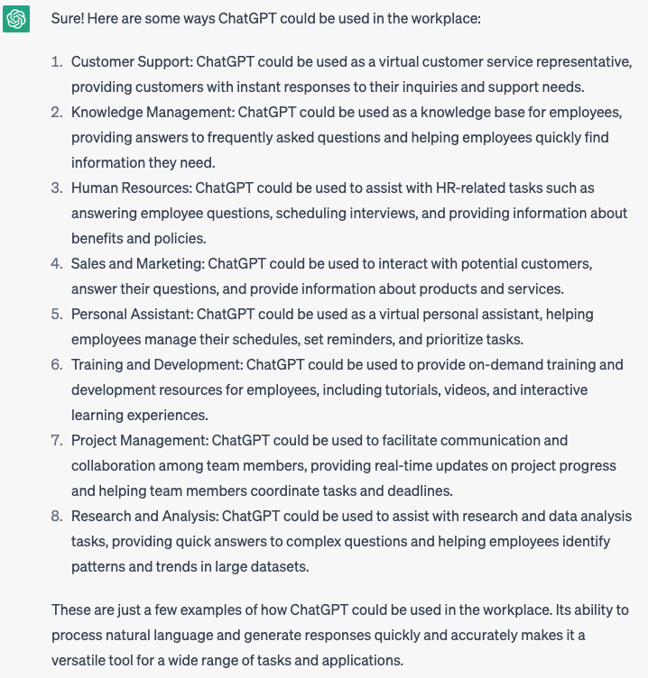
Generative AI Tools in the
Workplace
When asked to create a list of ways it can be used in the workplace, this was chatGPT’s response:
Customer Support
Knowledge Management
Human Resources
Sales and Marketing
Personal Assistant
Training
Project Management
Research
We could probably spend hours thinking of new ways to use a tool like chatGPT at work…
Notes:
PURPOSE: One sentence about why this slide is included/how it gets us closer to our learning goals.
TALKING POINTS
This is a suggested talking point for instructors.
Bullets are better than paragraph-y scripts.
TEACHING TIPS
Have a suggestion for what an instructor should do while teaching to this slide? Put it here!
This is an optional section. Not all slides require facilitation tips.

Slide 24
AI Tools in the Workplace
5 Minutes
Partner Exercise:
Generative AI Tools in the Workplace
Work with a partner or small group and brainstorm together
Keep track of your list on a piece of paper
Be ready to share!
Create a list of advantages and disadvantages of using AI in the workplace.
Notes:
TEACHING TIPS
Before feilding responses, go to the next slide and fill in the chart with responses from the class.

Slide 25
5 Minutes
Generative AI Tools: Pros and Cons
ADVANTAGES | DISADVANTAGES
Notes:
PURPOSE: Use this slide as a parking lot to keep the class’ answers from the last slide. Type directly into the slide, or project onto a whiteboard.

Slide 26
AI at Work
Things to consider when using LLMs at work
1
2
3
4
LLMs like ChatGPT are tools; not replacements for human expertise.
Be specific and clear in your prompts. The output will only be as good as the input you provide!
Remember that LLMs are not oracles. They are machine learning models that may not be accurate or up-to-date.
Keep data privacy in mind. OpenAI stores a log of all the prompts entered into CHatGPT. This data is then used in future training!
Notes:
PURPOSE: To introduce students to some of the things they need to be aware of when using LLM’s at work.
TALKING POINTS
Let students know that the rest of the lessons in the Leveraging AI Series will go into more detail on each of the points on this slide.

Slide 27
Real World Concerns
Understanding Generative AI Tools

Slide 28
Artificial Intelligence Concerns
5 minutes
Discussion: Artificial Intelligence Concerns
Read this open letter asking for a pause to AI experiments
Take a few moments to consider the questions below
Be ready to share your answers to the class
What is your reaction to the concerns voiced in the letter? Do you think they are valid? Why or why not?
Notes:
PURPOSE: To get students to think critically about the implications AI has on our world.
TALKING POINTS
Alllot 5 minutes for reading and 5 minutes for discussion
TEACHING TIPS
Have a suggestion for what an instructor should do while teaching to this slide? Put it here!
This is an optional section. Not all slides require facilitation tips.

Slide 29



Real-World Examples
Real People, Fake Stories
ChatGPT claimed a law professor had been at the center of a sexual harassment scandal. It even cited WaPo article that didn’t exist as a source!
Source: Washington Post
The Honorable, ChatGPT
A judge in Pakistan was asking ChatGPT legal questions before making decisions in civil and criminal cases!
Source: Pakistan Today
ChatGPT’s Data Dilemma
It is estimated that 10% of data that employees paste into ChatGPT is confidential!
Source: Cyber Haven
Notes:
Teaching Tips
Use each of these examples to demonstrate the real-world impacts LLM technology is already having
Allow room for discussion and let students drive conversation as much as time allows
If you know of other examples of real-world concerns bring those up as well

Slide 30

AI is More Than ChatGPT
AI is a Tool
AI Should be Used Responsibly
Large Language Models like ChatGPT are just one small part of Artificial intelligence as a whole.
AI is a tool people can use to be more productive, but it still requires human expertise.
Understanding data privacy and ethics is a critical part of using AI effectively and safely at work.
Notes:
PURPOSE: One sentence about why this slide is included/how it gets us closer to our learning goals.
TALKING POINTS
This is a suggested talking point for instructors.
Bullets are better than paragraph-y scripts.
TEACHING TIPS
Have a suggestion for what an instructor should do while teaching to this slide? Put it here!
This is an optional section. Not all slides require facilitation tips.

